Slide 1
Introducing into CI/CD
External training <EPAM> DevOps KNURE_Winter 2020.
Made by
Kostenko Anatolii

Slide 2
Used technologies:
Terraform – launch as many servers as needed*
GCP – cloud provider
Jenkins – Continuous integration
Git – version control
Apache – web server
Code – two lines in index.html file
Ansible – deploy to all servers**

Slide 3
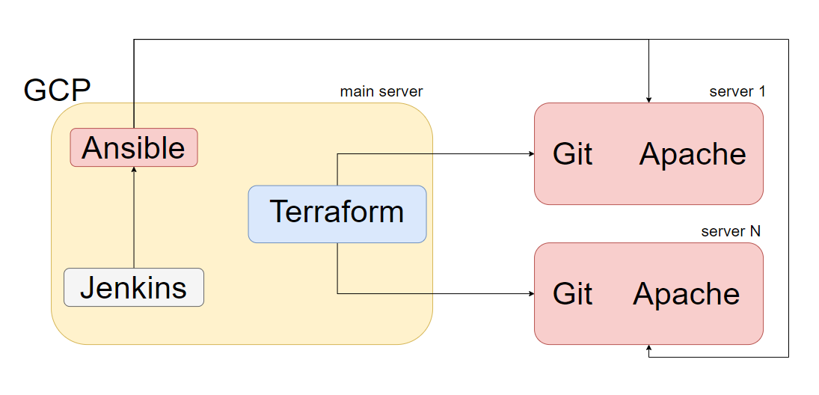
Infrastructure

Slide 4
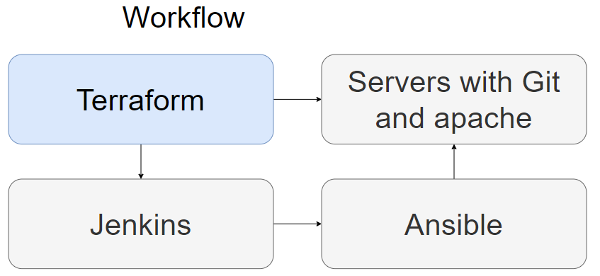

Slide 5
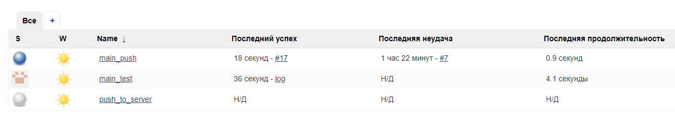
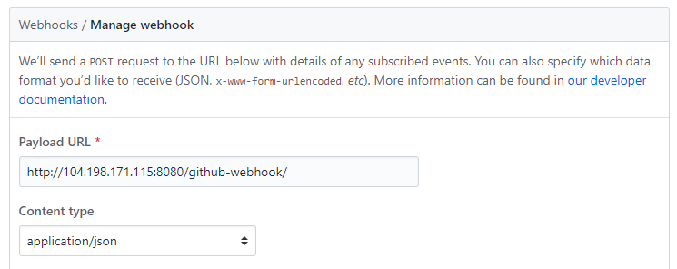
Steps:
Create initial server
Setup Terraform, Jenkins and Ansible
SSH configuration
Github setup

Slide 6
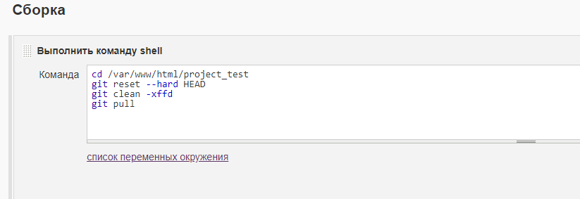
Jenkins
Main steps in Jenkins setup – create job, add webhook and commands to launch after successful build

Slide 7
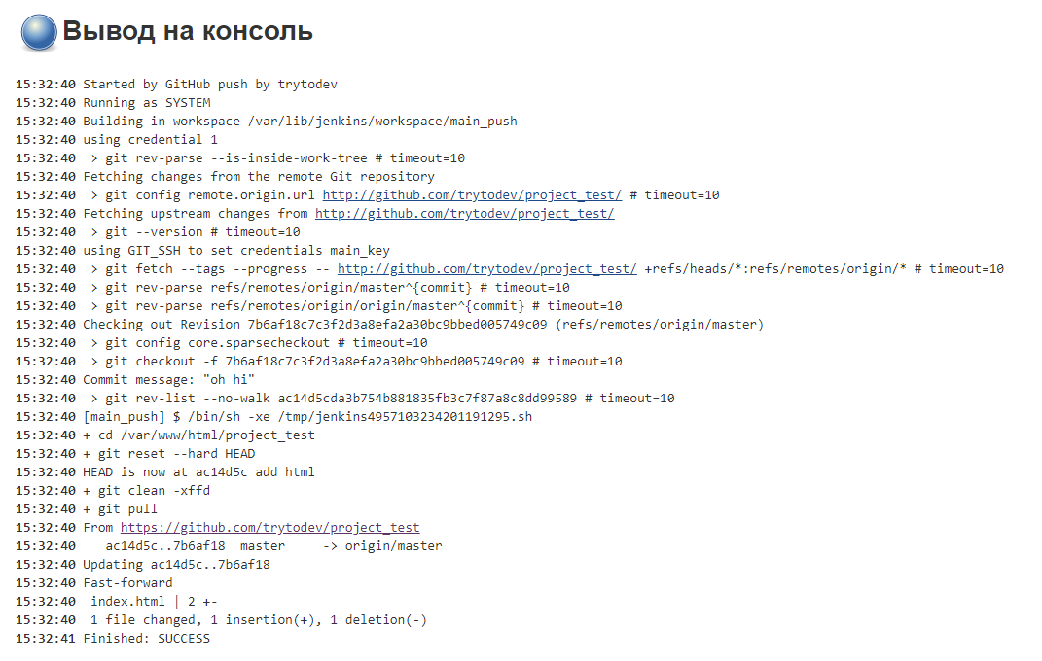
Build results

Slide 8
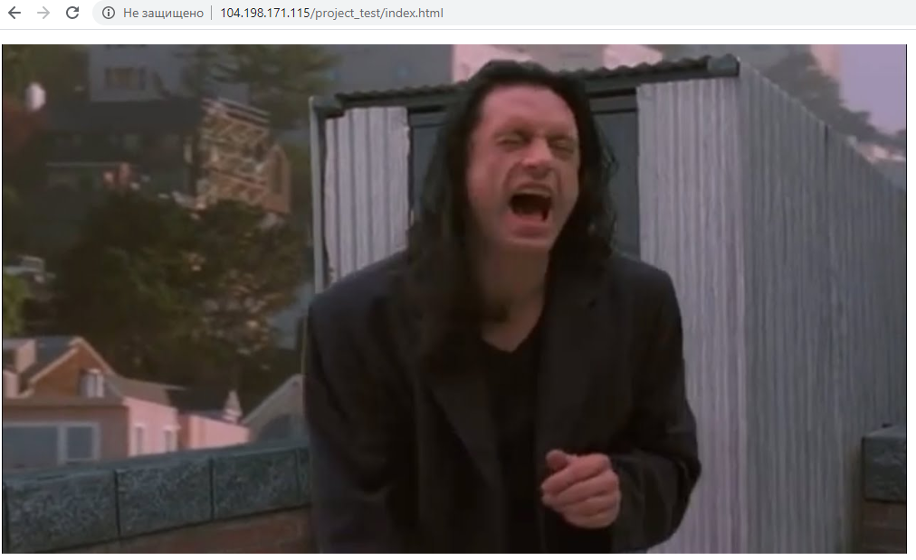
That’s all! Thank you for your attention and feel free to ask questions.

